Slide 1
FUNDAMENTALS OF
SPACTIAL FILLTERING
Notes:
Today I’ll be presenting on FUNDAMENTALS OF SPACTIAL FILLTERING
– a fundamental technique used to enhance image quality before deeper analysis.

Slide 2
TABLE OF CONTENT
01
FUNDAMENTALS OF SPACTIAL FILLTERING
02
LOWPASS FILTER
03
INTERPOLATION
Notes:
“Here’s the roadmap for this talk. We’ll start with basic transformations, then move into histogram analysis. After that, we’ll conclude with key takeaways and applications.”

Slide 3
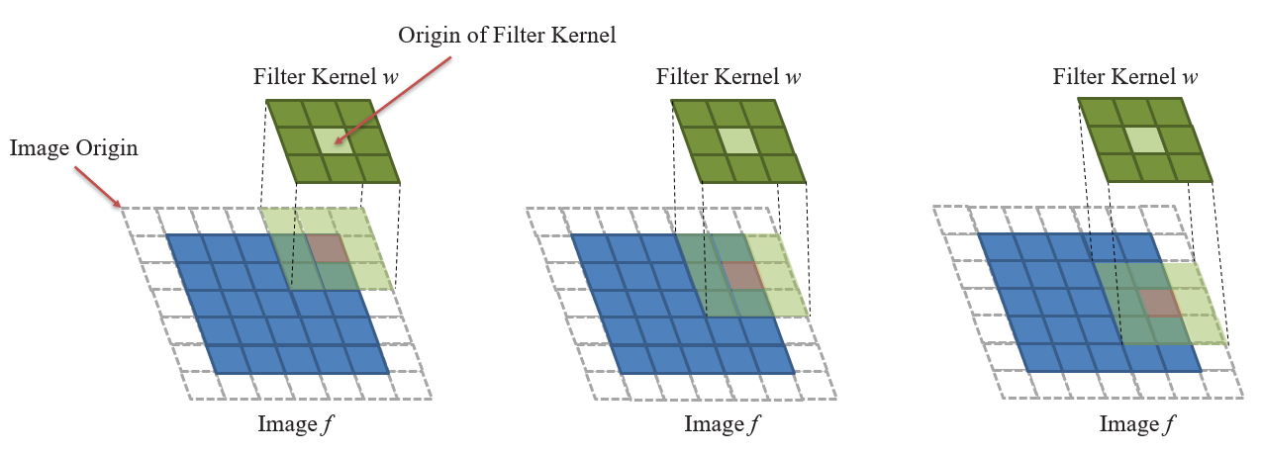
SPACTIAL FILLTERING
Spatial filtering modifies pixel values using their neighbors.
Operates in the spatial domain
Used for:
Smoothing
Sharpening
Edge detection
Notes:
Spatial filtering is the process of modifying a pixel value by considering the values of its surrounding neighbors.
This technique operates directly in the spatial domain of the image.
It is used for smoothing, enhancing, or detecting edges.
A linear spatial filter performs a sum-of-products operation between an image f and a filter kernel, w.
A filter kernel is a matrix that have size 3x3, 5x5 and so on.
Any terms used to refer to a spatial filter kernel are mask, template, and window.

Slide 4
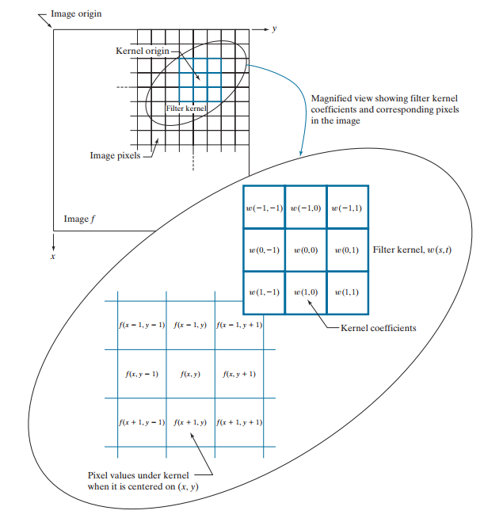
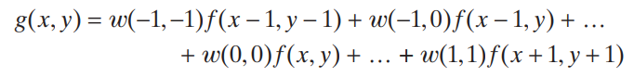
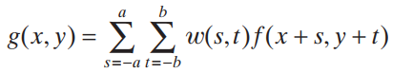
How does it work ?
s, t: The pixel coordinates relate to the center of the kernel
With a kernel of size m x n → m = 2a + 1 and n = 2b + 1
Notes:
This figure illustrates the mechanics of linear spatial filtering using a 3 multiply 3 matrix.
At any point (x, y) in the image, the response, g (x , y), of the filter is the sum of products of the kernel w and the image pixels encompassed by the kernel:
Observe that the center coefficient of the kernel, w( , 0 0), aligns with the pixel at location ( , ). x y As coordinates x and y are varied, the center of the kernel moves from pixel to pixel, generating the filtered image, in the process.
From the formula above, we derive the general formula as shown here.
For a kernel of size m multiply ν , we assume that m a = + 2 1 and n b = + 2 1
s takes values from Negative a to a. and t have range from Negative b to b

Slide 5
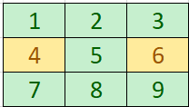
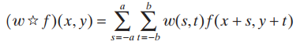
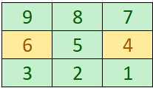
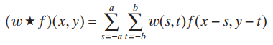
SPATIAL CORRELATION AND CONVOLUTION
w
Correlation
Rotated w
Convolution
Notes:
Correlation consists of moving the center of a kernel over an image, and computing the sum of products at each location. The mechanics of spatial convolution are the same, except that the correlation kernel is rotated by 180°.

Slide 6
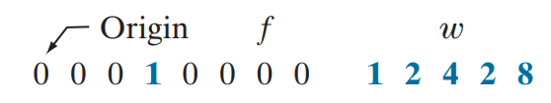
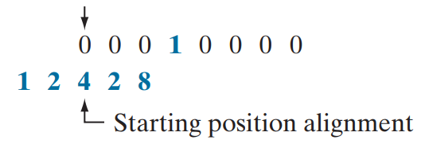
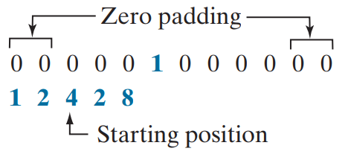
SPATIAL CORRELATION AND CONVOLUTION
Correlation
W size 1 x 5 (1 x m)
=> Padding (m – 1) / 2 = 2 zeros on either side
Notes:
An example of a 1-dimensional function, f, and a kernel, w.
A function that contains a single 1 with the rest being 0’s is called a discrete unit impulse. Due to the center of the kernel coincides with the origin of the image, we need set part of w lies outside f.
So the summation is undefined in that area.
A solution to this problem is to pad function f with enough 0’s on either side.
In general, if the kernel is of size 1 ⋅ m, we need (m – 1) / 2 zeros on either side of f in order to handle the beginning and ending configurations of w

Slide 7
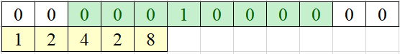
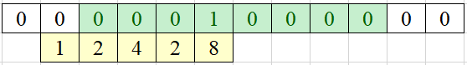
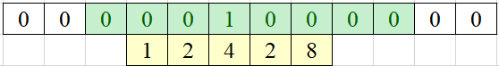
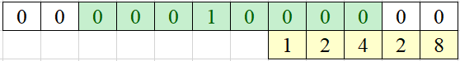
SPATIAL CORRELATION AND CONVOLUTION
Correlation
Start position
Result = 1x0 + 2x0 + 4x0 + 2x0 + 8x1
Position after 1 shift
Result = 1x0 + 2x0 + 4x1 + 2x0 + 8x0
Position after 3 shift
Final Position
Notes:
Correlating a kernel with a discrete unit impulse yields a rotated version of the kernel at the location of the impulse.
the result is a copy of the kernel, rotated by 180°

Slide 8
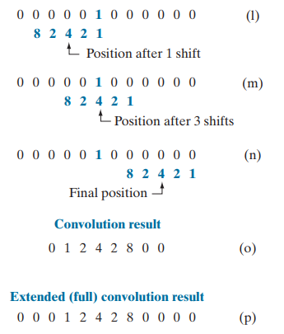
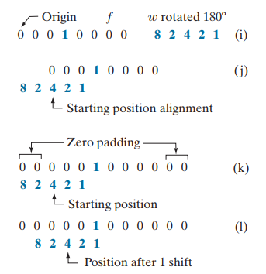
SPATIAL CORRELATION AND CONVOLUTION
Convolution
Notes:
You see again
that convolution of a function with an impulse copies the function to the location of the impulse.

Slide 9
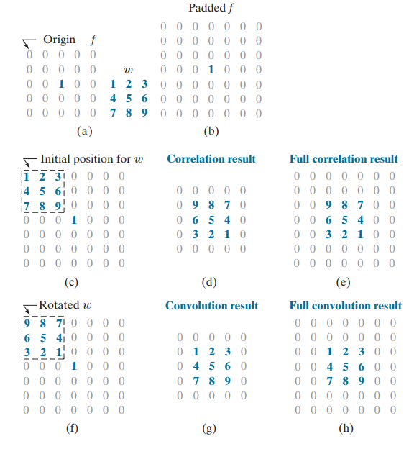
SPATIAL CORRELATION AND CONVOLUTION
In spatial filtering, the filter mask (or kernel) depends on two main factors:
- Kernel Size (Mask Dimensions)
+ Small kernels (e.g., 3×3) preserve more details.
+ Larger kernels (e.g., 5×5 or more) smooth more aggressively but may blur important features.
- Kernel Coefficients (Weights):
+ Uniform coefficients → Smoothing (Box filter).
+ Centered high weights → Gaussian blur.
+ Positive and negative values → Edge detection
Notes:
This refers to the size of the filter matrix, commonly odd dimensions like 3×3, 5×5, 7×7, etc., so that the filter has a central pixel.
The size determines the neighborhood of pixels that will influence the output:
Small kernels (e.g., 3×3) preserve more details.
Larger kernels (e.g., 5×5 or more) smooth more aggressively but may blur important features.
These are the numerical values inside the kernel that determine how each neighboring pixel contributes to the result.
They define the type of filtering:
Uniform coefficients → smoothing (e.g., mean filter).
Centered high weights → Gaussian blur.
Positive and negative values → edge detection (e.g., Sobel, Laplacian).

Slide 10
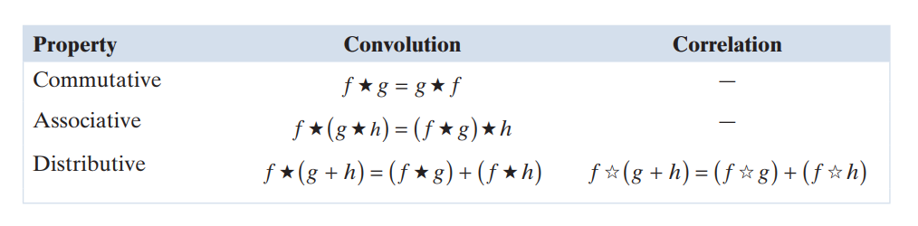
Some properties of Convolution and Correlation

Slide 11
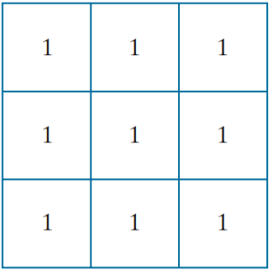
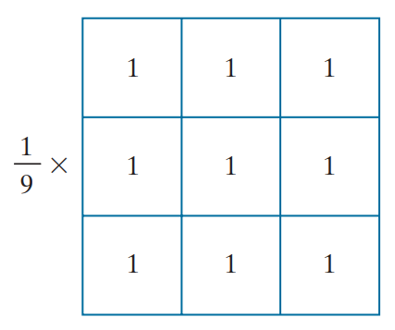
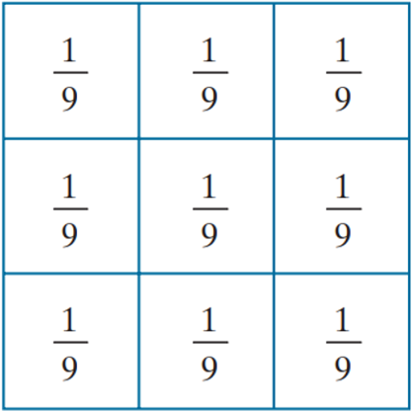
BOX FILTER KERNEL
Normalize
Box filter kernel
Sum of the value of the coefficients = 9
Normalize:
To ensure that the sum of all values in the kernel equals 1.
When applied to a region with uniform intensity (e.g., all pixels have a gray value of 100), the filtered result should retain the same intensity.
To prevent increasing or decreasing the overall brightness of the image (i.e., to avoid altering the overall color balance).
Notes:
The simplest, separable lowpass filter kernel is the box kernel, whose coefficients of kernel have the same value (typically 1)

Slide 12




BOX FILTER KERNEL
Test pattern
size 1024x1024 pixels
Filtering with box kernels of sizes 3x3
Filtering with box kernels of sizes 11x11
Filtering with box kernels of sizes 21x21
Notes:
4 Figure shows the results of applying kernel filters of different sizes to a test pattern image of size 1024 × 1024 pixels.
For m = 3, we note a slight overall blurring of the image The filtered image also has a thin gray border, the result of zero-padding the image prior to filtering Using the 11 11 ⋅ kernel resulted in more pronounced blurring throughout the image, including a more prominent dark border
The result with the 21 21 ⋅ kernel shows significant blurring of all components of the image, including the loss of the characteristic shape of some components, including, for example, the small square on the top left and the small character on the bottom left. The result with the 21 21 ⋅ kernel shows significant blurring of all components of the image, including the loss of the characteristic shape of some components, including, for example, the small square on the top left and the small character on the bottom left.

Slide 13
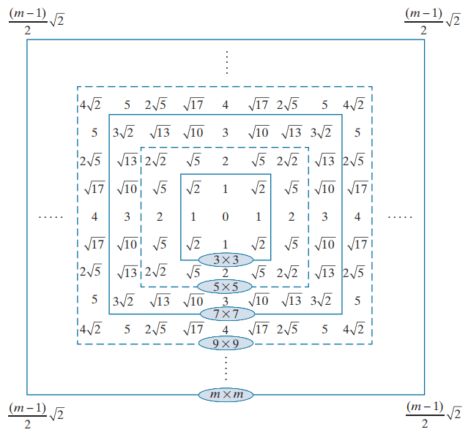
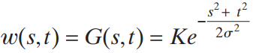
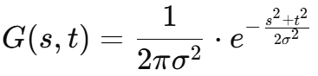
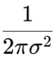
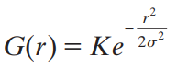
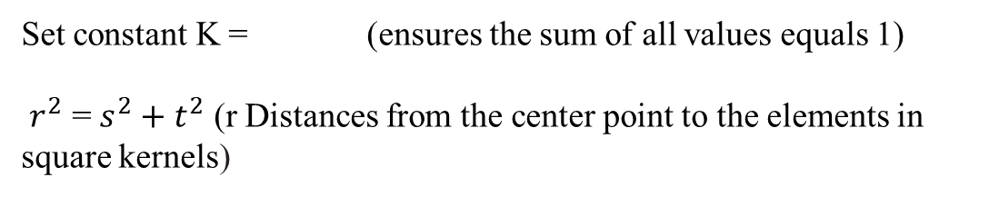
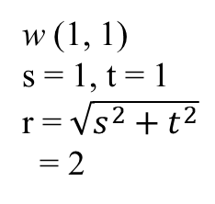
GAUSSIAN FILTER KERNEL
w (1, 1)
s = 1, t = 1
r = $\sqrt{s^{2}+t^{2}}$
= 2
s, t: The pixel coordinates relate to the center of the kernel
σ: The standard deviation (controls the amount of blur)
Set constant K = (ensures the sum of all values equals 1)
$r^{2}$ = $s^{2}+t^{2}$ (r Distances from the center point to the elements in square kernels)
Distances from the center for various sizes of square kernels.
Notes:
A Gaussian kernel filter (or Gaussian blur) is a type of image processing filter used to smooth or blur images and remove noise. It's based on the Gaussian function

Slide 14
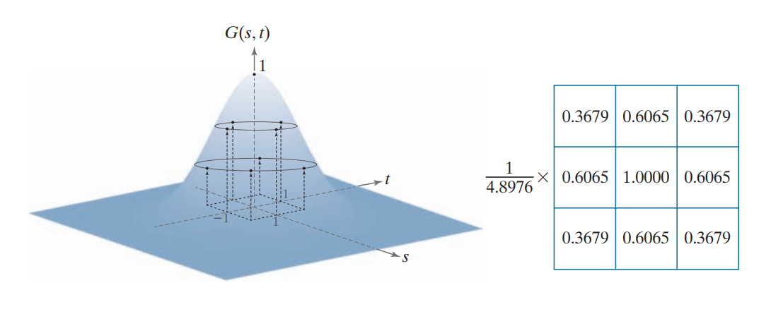
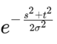
GAUSSIAN FILTER KERNEL
With s = -1 and t = -1
Constant K
Bell shape of the Gaussian function
Sum of the value of the coefficients

Slide 15

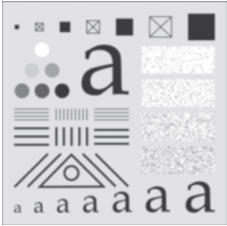


Comparing the Box kernel and the Gaussian kernel
Original image
Box kernel 21x21
Gaussian kernel 21x21
Gaussian kernel 43x43
Notes:
Comparing the Box kernel and the Gaussian kernel you'll notice that with kernels of the same size, the box kernel blurs and distorts the shape of the image, while the Gaussian kernel only blurs it. Compared to a 43x43 Gaussian kernel, we see that the level of blur is similar, but when using the Gaussian kernel, the shapes of the details are still preserved. Therefore, in image processing, when the goal is to smooth the image, the Gaussian kernel is more commonly used."

Slide 16
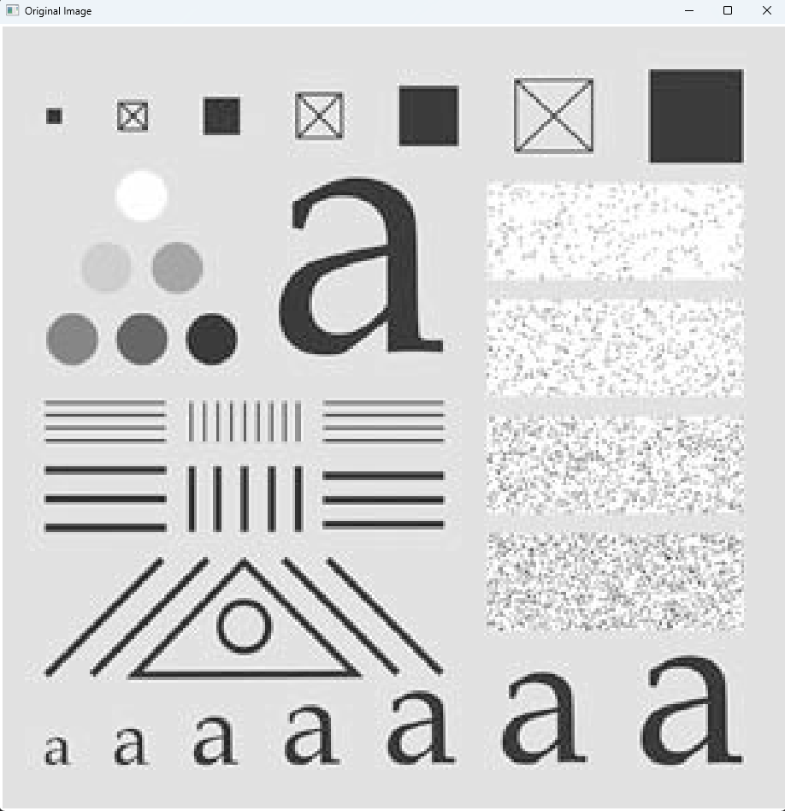
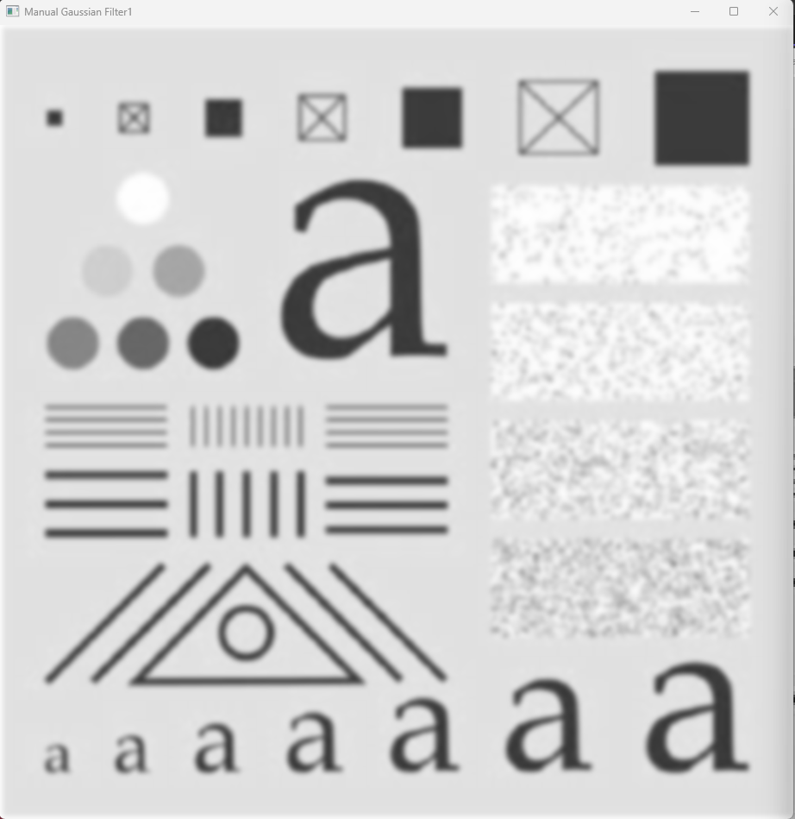

GAUSSIAN FILTER KERNEL
Original Image
Gaussian Filter 25x25, σ = 3.0
Gaussian Filter 25x25, σ = 5.0

Slide 17
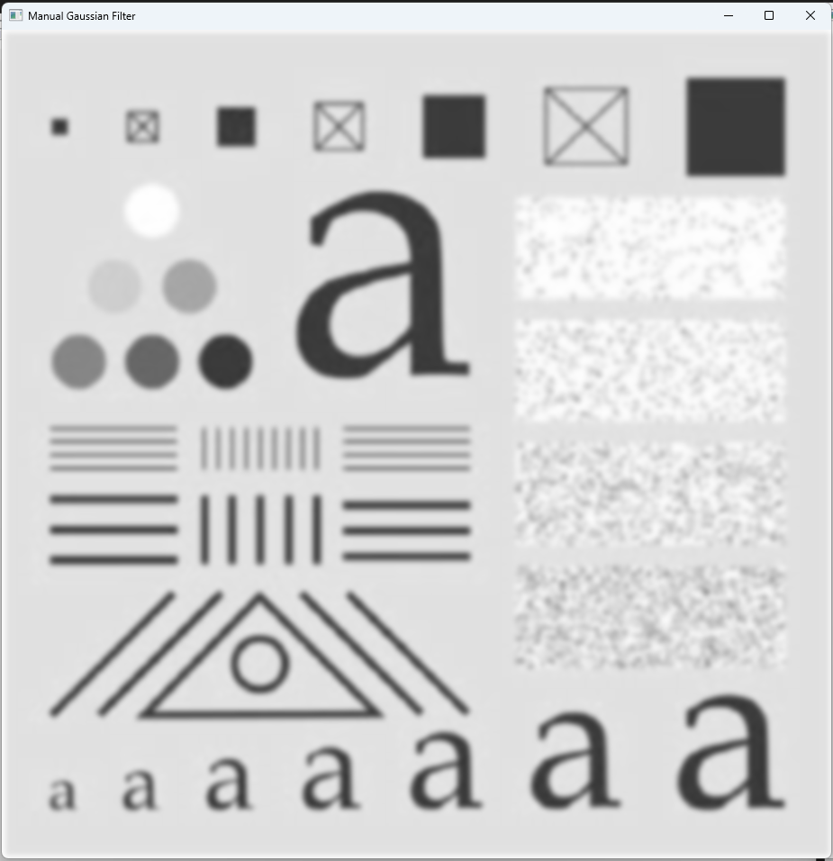

GAUSSIAN FILTER KERNEL
Manual Gaussian Filter
OpenCV Gaussian Filter

Slide 18

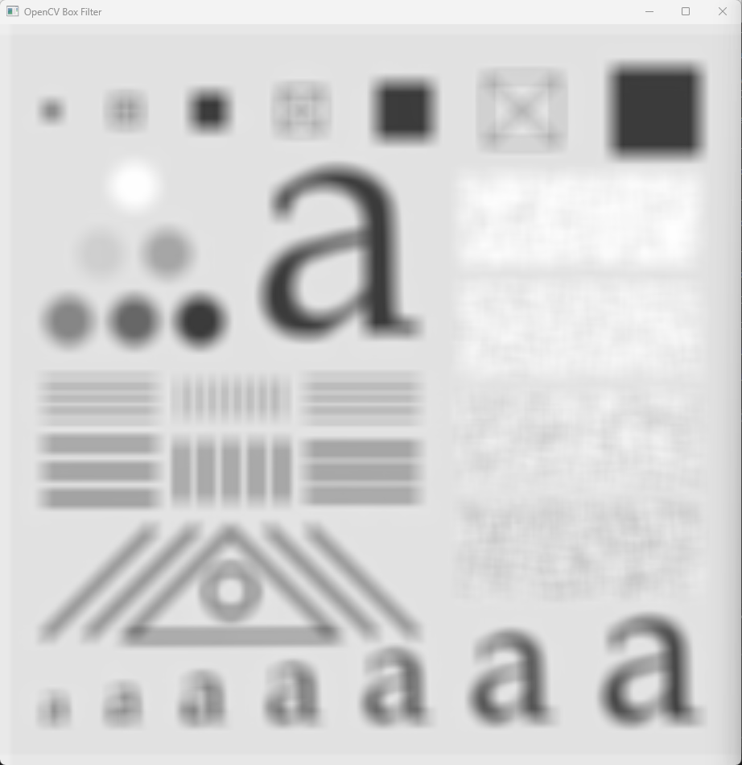
BOX FILTER KERNEL
Manual Box Filter
OpenCV Box Filter

Slide 19
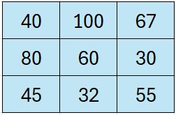
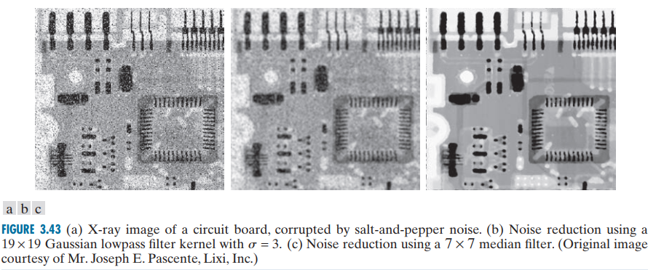
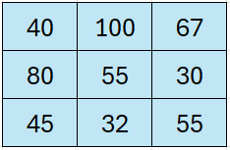
Median filtering
region encompassed by the filter
Half the values $≤$Median value $≤$ Haft of the value
Step 2: Ditermine the median
Size of the filter is 3x3 → 9 value
Step 3: Assign that value to the pixel
Notes:
The median, j, of a set of values is such that half the values in the set are less than or equal to j and half are greater than or equal to j. In order to perform median filtering at a point in an image, we first sort the values of the pixels in the neighborhood, determine their median, and assign that value to the pixel

Slide 20
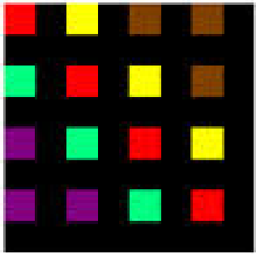
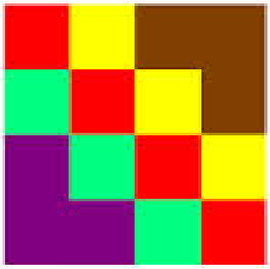
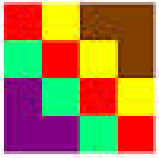
Resizing Images

Slide 21
Resizing Images
These new pixels are generated using interpolation
4 pixel
8 pixel
pyrDown() in OpenCV: automatically applies Gaussian blur and remove every even-numbered row and column to downsamples by a factor of 2.
Notes:
You're reducing the number of pixels
But instead of just throwing away pixels, smart algorithms are used to combine and average nearby pixels.

Slide 22
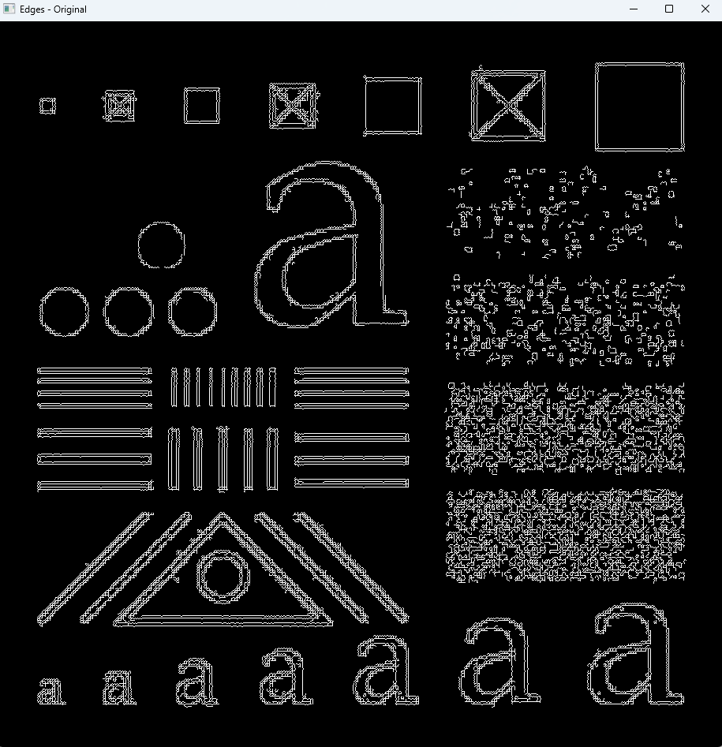
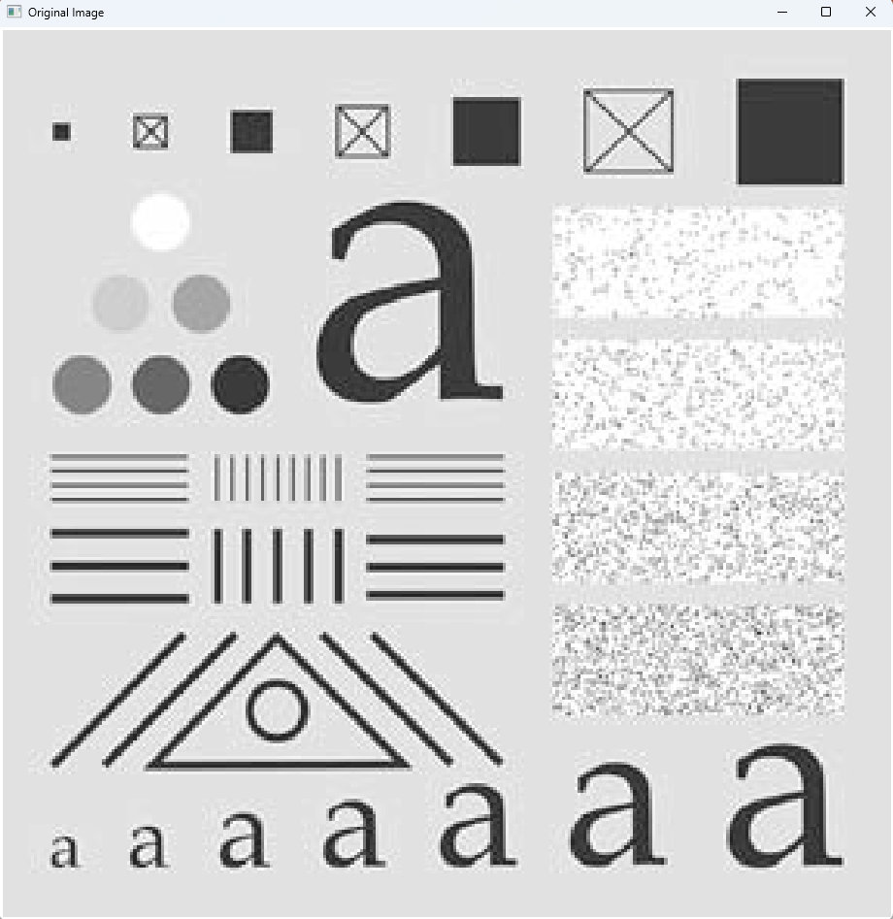
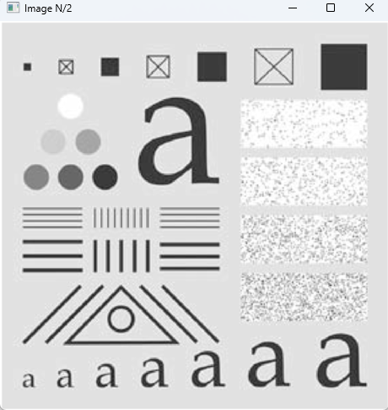
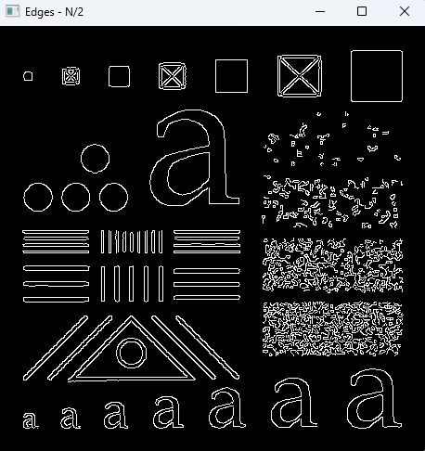
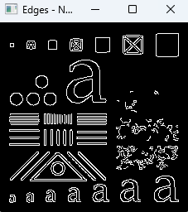

Down Size
¼ Size of original image
½ Size of original image
Original image
Notes:
Apply the PyrDown() twice

Slide 23
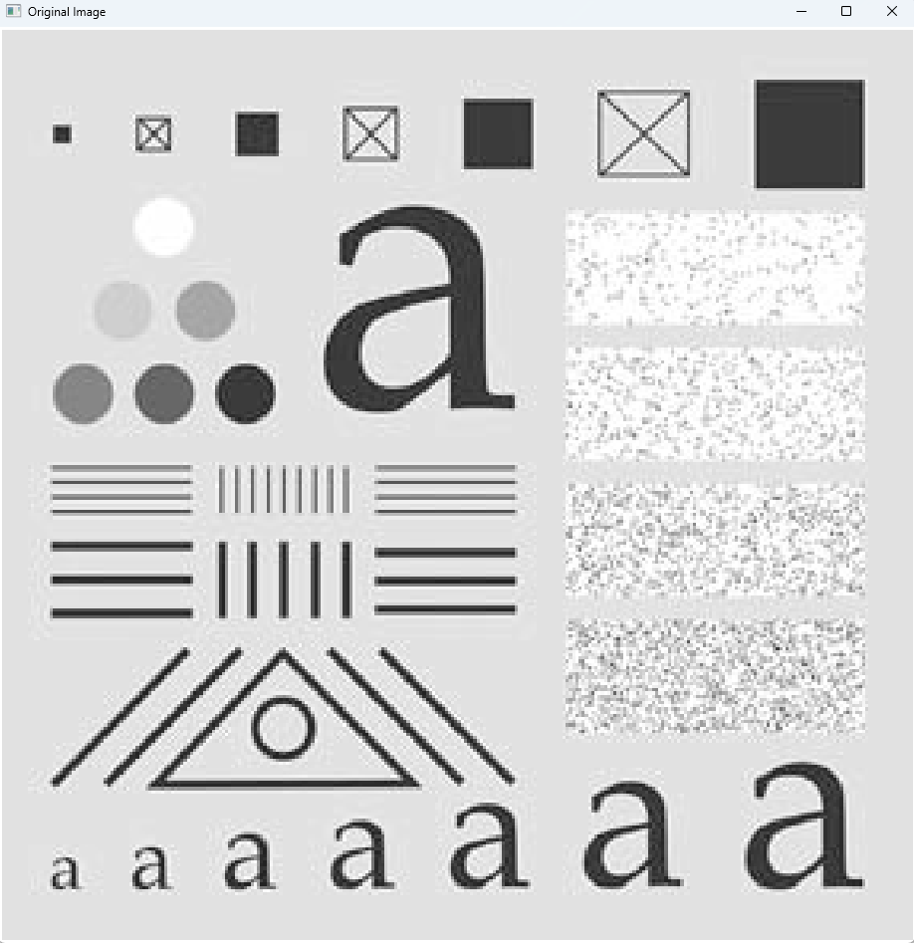
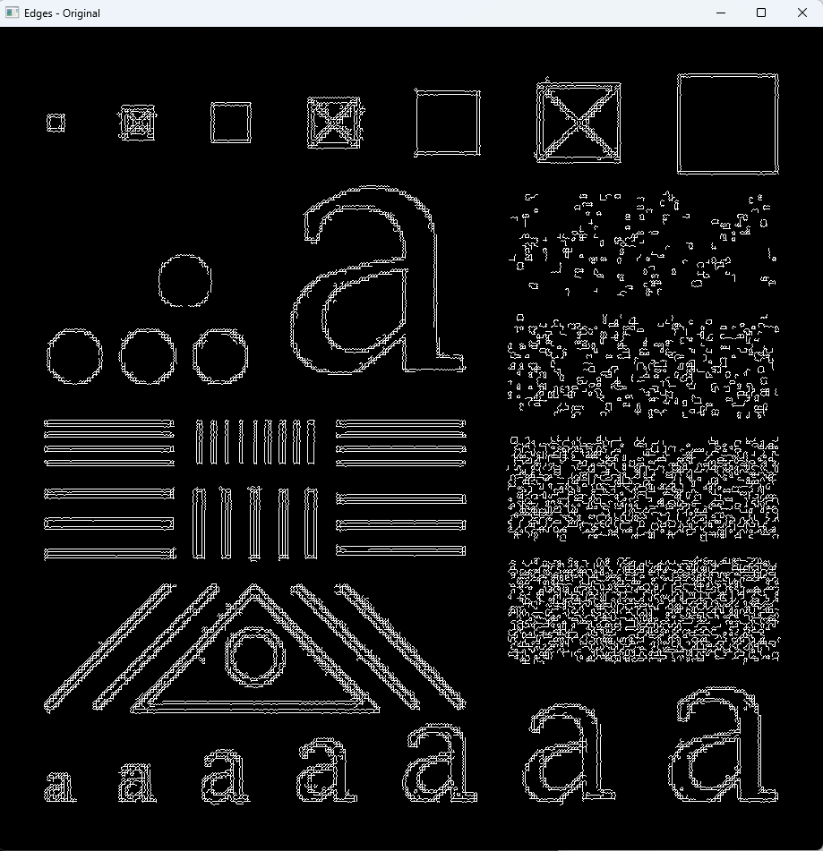
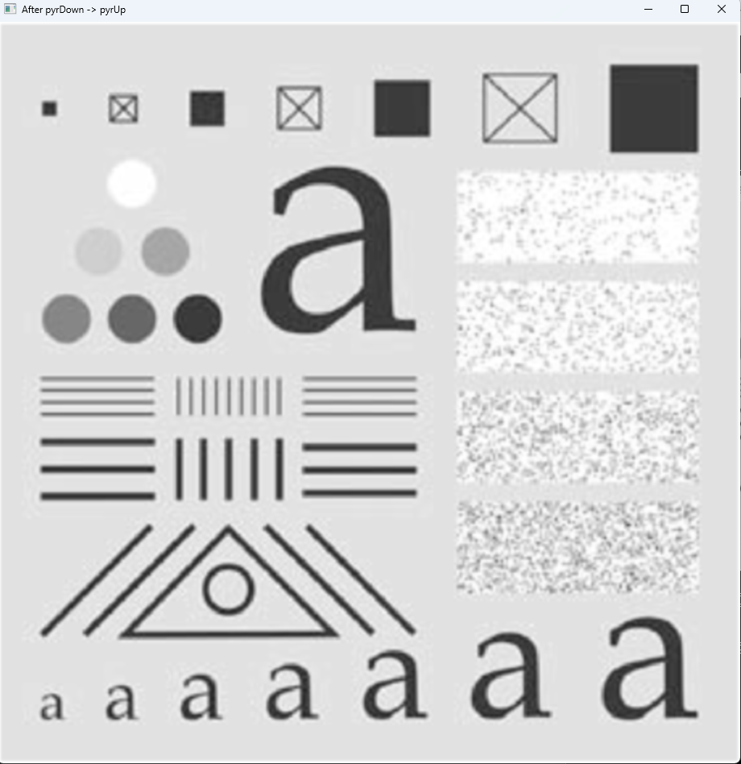



Up Size
Using interpolation
Notes:
apply the pyrDown() to an image and then again apply the pyrUp() to that image to have the same size of original image.

Slide 24
Nearest Neighbor Interpolation

Slide 25


Nearest Neighbor Interpolation
1-D Interpolation
Intensity
Intensity
Position
Position
Notes:
Nearest neighbour interpolation is the simplest approach to interpolation.
let’s consider this in a 1-dimensional case
this method simply determines the “nearest” neighbouring pixel, and assumes the intensity value of it.
We can see above that for each data point, xi, between our original data points, x1 and x2, we assign them a value f(xi) based on which of the original data points was closer along the horizontal axis.

Slide 26


Nearest Neighbor Interpolation
2D Interpolation
2×2 pixel image
640×480 pixel image
Notes:
As shown in the images below, the 2×2 checkerboard image was upsampled to a 640×480 pixel image without any changes at all. Furthermore, due to the simplicity of this algorithm, the operation takes very little time to complete. The key point here is that this is a simple and fast algorithm.

Slide 27




Nearest Neighbor Interpolation
Small image of an “X”
Small image of tree
Using a better interpolation method
Notes:
As we can see in the results above (you can click on it to get a better view) the results are of poor quality.
jagged edges
Low resolution

Slide 28


Linear Interpolation
1D Interpolation
Intensity
Intensity
Position
Position
Notes:
Now, assume that we want more data points in between these values. We’ve already seen what happens with nearest neighbour interpolation – we get a jagged discountinuous approximation. We want something better! We will make the values, , for each datapoint, , where , between and , fit on a line, as shown below:

Slide 29

Linear Interpolation

Slide 30












Bilinear Interpolation
Objective: Find the value of point P (x, y).
Interpolate along the X-axis first to obtain R1 and R2.
Interpolate R1, R2 along the Y-axis to obtain P.
Notes:
The goal is to find the value of point P.

Slide 31

Bilinear Interpolation
Nearest Neighbor Interpolation
Bilinear Interpolation
Notes:
the image is smoother and general looks better. while the image on the right has blurred edges

Slide 32

Bilinear Interpolation
Nearest Neighbor Interpolation
Bilinear Interpolation
Notes:
This is even more pronounced with a source image with only two intensity values
The jagged edges have disappeared. But the edge of X character is blured.

Slide 33

Bilinear Interpolation
Original Image
Original Image OpenCV
Manual CLAHE
Not using Bilinear Interpolation
Manual CLAHE
Using
Bilinear Interpolation

Slide 34



Interpolation
discontinuities point
discontinuities point
Nearest Neighbor Interpolation
Linear Interpolation
Spline Bicubic Interpolation

Slide 35

Nearest Neighbor Interpolation

Slide 36
Nearest Neighbor Interpolation

Slide 37
Nearest Neighbor Interpolation

Slide 38
Nearest Neighbor Interpolation

Slide 39
SPACTIAL FILLTERING
Origin of Filter Kernel
Filter Kernel w
Filter Kernel w
Filter Kernel w
Image Origin
Image f
Image f
Image f
Notes:
A filter kernel is a matrix that have size 3x3, 4x4, etc

Slide 40

Nearest Neighbor Interpolation
2×2 pixel image
9x9 pixel
9x9 pixel image

